Slide 1
Invertible (Proof)

Slide 2
Summary
Let A be an n x n matrix. A is invertible if and only if
The columns of A span R^{n}
For every b in R^{n}, the system Ax=b is consistent
The rank of A is n
The columns of A are linear independent
The only solution to Ax=0 is the zero vector
The nullity of A is zero
The reduced row echelon form of A is I_{n}
A is a product of elementary matrices
There exists an n x n matrix B such that BA = I_{n}
There exists an n x n matrix C such that AC = I_{n}
Notes:
When A is square, one side is sufficient.

Slide 3
Invertible
Let A be an n x n matrix.
Onto → One-to-one → invertible
The columns of A span R^{n}
For every b in R^{n}, the system Ax=b is consistent
The rank of A is the number of rows
One-to-one → Onto → invertible
The columns of A are linear independent
The rank of A is the number of columns
The nullity of A is zero
The only solution to Ax=0 is the zero vector
The reduced row echelon form of A is I_{n}
Rank A = n

Slide 4
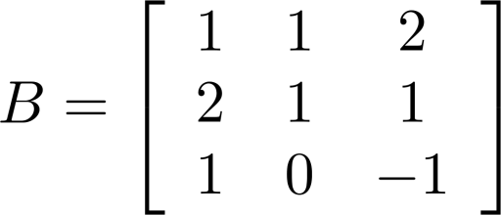
Is A Invertible?
Let A be an n x n matrix. A is invertible if and only if
The reduced row echelon form of A is I_{n}
I_{n}
RREF
Invertible
RREF
Not Invertible

Slide 5
Summary
Let A be an n x n matrix. A is invertible if and only if
The columns of A span R^{n}
For every b in R^{n}, the system Ax=b is consistent
The rank of A is n
The columns of A are linear independent
The only solution to Ax=0 is the zero vector
The nullity of A is zero
The reduced row echelon form of A is I_{n}
A is a product of elementary matrices
There exists an n x n matrix B such that BA = I_{n}
There exists an n x n matrix C such that AC = I_{n}
onto
square matrix
=
One-to-one
Notes:
When A is square, one side is sufficient.

Slide 6

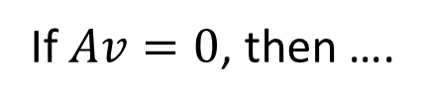



Invertible
A is n x n
There exists an n x n matrix B such that BA = I_{n}
A is invertible.
?
The only solution to Ax=0 is the zero vector
If $Av=0$, then ….
$$BA=I_{n}$$
$$v=0$$
$$BAv=0$$
$$I_{n}v=v$$

Slide 7

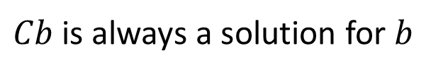


Invertible
A is n x n
There exists an n x n matrix C such that AC = I_{n}
A is invertible.
?
For every b in R^{n}, Ax=b is consistent
For any vector b,
$$AC=I_{n}$$
$Cb$ is always a solution for $b$
$$ACb$$
$$I_{n}b=b$$
Notes:
Another way
E1 is linear combination
E2
…
en

Slide 8
Summary
Let A be an n x n matrix. A is invertible if and only if
The columns of A span R^{n}
For every b in R^{n}, the system Ax=b is consistent
The rank of A is n
The columns of A are linear independent
The only solution to Ax=0 is the zero vector
The nullity of A is zero
The reduced row echelon form of A is I_{n}
A is a product of elementary matrices
There exists an n x n matrix B such that BA = I_{n}
There exists an n x n matrix C such that AC = I_{n}
onto
square matrix
=
One-to-one
Notes:
When A is square, one side is sufficient.

